Slide 1

Open Science for Qualitative Research

Slide 2
Status Quo
Mostly discussed in political science (e.g., APSA Qualitative Transparency Deliberations https://www.qualtd.net)
Debate developed from ‘Whether?’ to ‘How?’

Slide 3
Existing Reporting Standards Make Reference to Transparency
APA Reporting Standards of Qualitative Research (2018):
Contextualisation of study - reflection on context of data collection and researchers’ context
Demonstrate ways that interpretations were shaped or observations were formed
Describe the researchers’ backgrounds in approaching the study, emphasising their prior understandings of the phenomena under study (e.g., interviewers, analysts, or research team)
Describe the process via which the number of participants was determined in relation to the study design
Provide any changes in numbers through attrition and final number of participants/sources (if relevant, refusal rates or reasons for dropout).
Describe the rationale for decision to halt data collection (e.g., saturation).
Convey the study purpose as portrayed to participants, if different from the purpose stated
…..

Slide 4
A Note on Multi-method Research
Establish equal standards for different types of studies
Ideally a consistent open science approach across the whole research program

Slide 5
Pre-registration for Qualitative Research
Why pre-registration may not seem suitable:
Qualitative research uses an “emergent design,” referring to the iterative process of combining data analysis, preliminary data inspection, and data collection
Parallel between qualitative research and postdiction: data are collected for the purpose of generating hypotheses instead of testing hypotheses
The researcher has the freedom to engage in a cyclic process of data collection and data analysis. E.g., the number of participants in the sample is not fixed beforehand, instruments may need to be adapted
Qualitative research is in essence not meant to test theory and, therefore, in most cases, will not make use of hypotheses

Slide 6
There are Still Plenty of Things to Pre-register
Study aim can be specified
Study design and plan can be registered - even if it changes (it may do so as well in quantitative studies)
Presuppositions associated with the data collection and analysis procedure should be made explicit (e.g., tradition and theoretical lens they work from, own values)
It is possible to ‘freeze’ pre-registration as a living document several times as design evolves

Slide 7
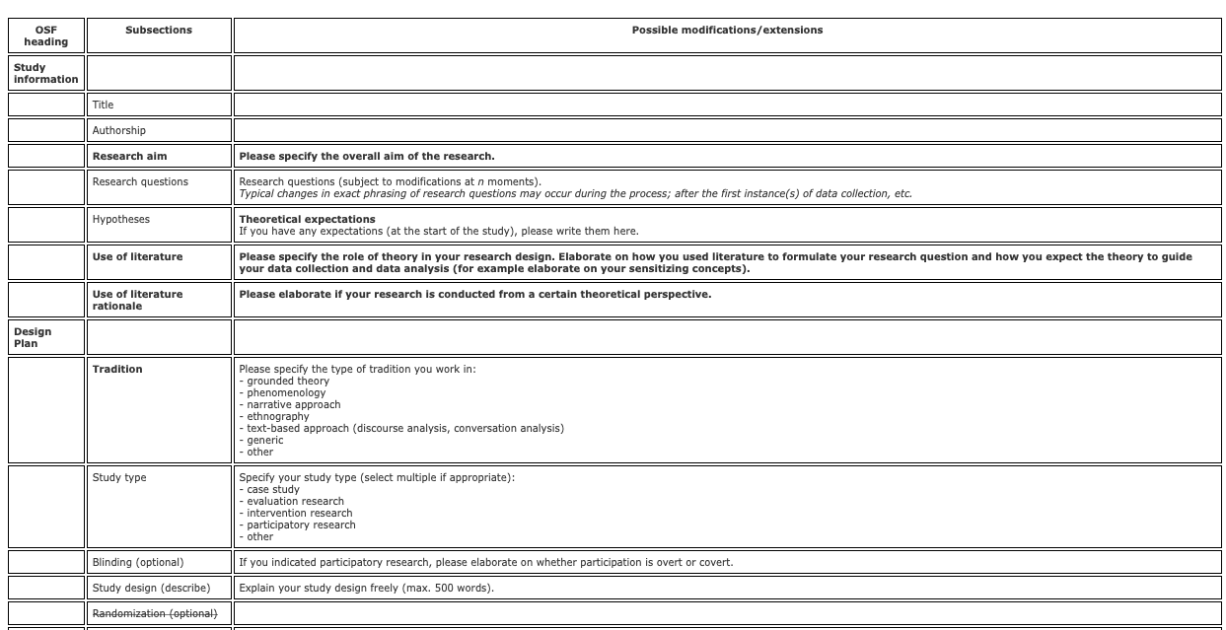
Adapted OSF Template

Slide 8
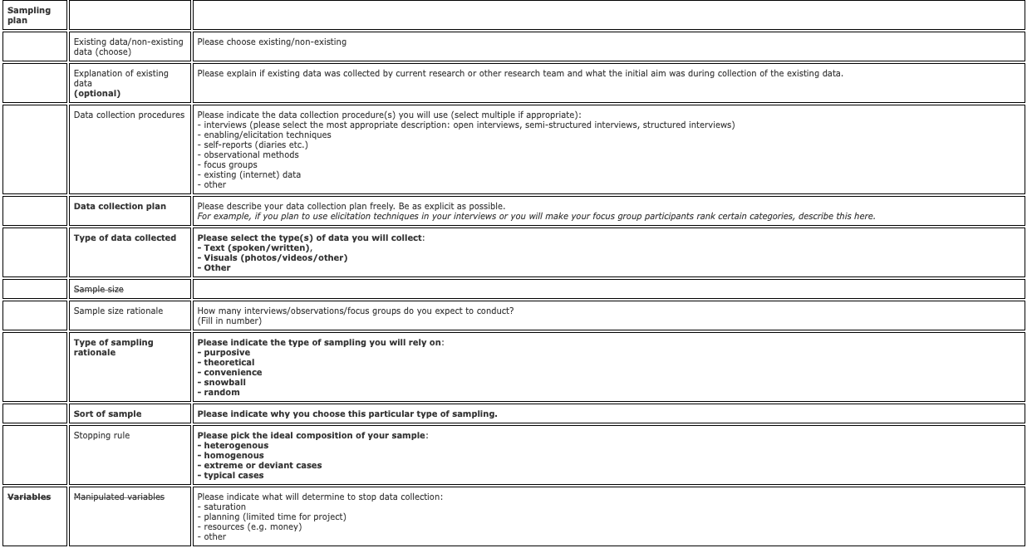
Adapted OSF Template

Slide 9
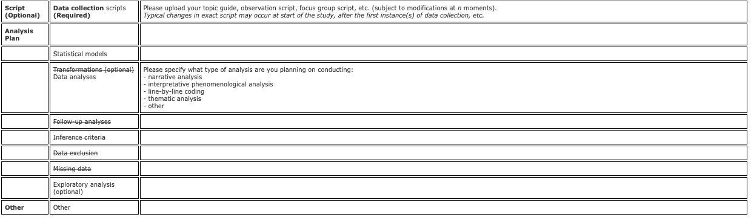
Adapted OSF Template

Slide 10
Added by Kern and Gleditsch (2017)

Slide 11
Qualitative Data Sharing

Slide 12
Why should we share qualitative data?
Replicability
Transparency - facilitating scrutiny, increased trust
Reuse for future research
Required by some funders and journals (e.g. PLOS)

Slide 13
What can we share?
Tsai et al. (2016):
Interview guides and interview transcripts, in the original language and in the translated language of the investigators (if different from the original)
Field notes
Data used, if any, to establish inter-coder reliability
Full code books
Documents, if any, describing the process of open coding, selection of codes for inclusion in the final codebook, and category construction

Slide 14
Some concerns…
Legal and ethical concerns
Replicability – context, researcher effects
Reuse – inappropriate uses, misinterpretation
Time to redact/anonymise data

Slide 15
Recommendations
Consent process
Anonymisation where possible – and from the start
Annotation and export from data analysis software – helps provide context/researcher rationale
Consider stepped/protected access (badges and specific repositories for this too – see Further Reading/Resources)
Sometimes, you won’t be able to share all the data. But you can share guides, codebooks, etc. You may also be able to share coding queries and extracts (see Tsai et al., 2016)

Slide 16
Further Reading/Resources
Pre-registration:
https://www.tandfonline.com/doi/full/10.1080/08989621.2019.1580147
https://www.redalyc.org/pdf/324/32449207009.pdf
Data sharing:
https://www.sciencedirect.com/science/article/pii/S0277953616304269#appsec1
https://osf.io/tvyxz/wiki/8.%20Approved%20Protected%20Access%20Repositories/
https://preprints.apsanet.org/engage/apsa/article-details/5d94c7762f41c7001256af6d
https://journals.sagepub.com/doi/full/10.1177/1609406918823863

